Slide 1
Hour of Code

Slide 2
Code Stars

Slide 3
How can I program a computer?
Requires “talking” to the computer
Collection of simple instructions to complete one larger task
Languages to translate “English” into “Computer Language”

Slide 4
Scratch
Scratch is a program built to very simply process computer language.
Commands are already in place, the user orders those commands to complete an action.
ShallWeLearn | http://shallwelearn.com

Slide 5
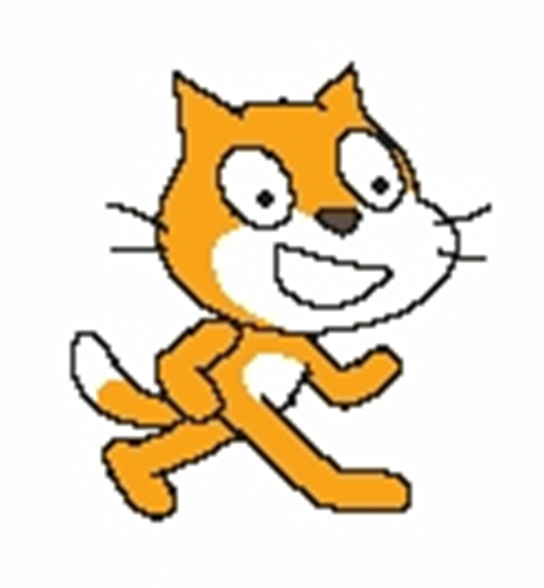
What is a Sprite?
A Sprite is a character.
The purpose of Scratch is to make your character perform some action:
Walk across the screen
Rotate
Speak
Maybe even dance!

Slide 6
Open Scratch Programming
Go to http://scratch.mit.edu
Click “Try It Out”

Slide 7
Walk through the Step-by-Step Tutorial

Slide 8
What else can we do?

Slide 9
Make Sprite Walk

Slide 10
Make Sprite Walk
Animation works by making repeated simple actions
Need to “move” over and over again
Use a repeat tool in the Control Menu
Problems making Sprite Walk?

Slide 11
Make Sprite Turn Around

Slide 12
Make Sprite Turn Around
Right now, Sprite keeps walking off the edge.
Problem Solve:
When does sprite need to turn around?
After how many moves?

Slide 13
Make Sprite Turn Around
Use the “if on edge, bounce” tool in the Motion menu

Slide 14
Make Sprite Box Step

Slide 15
Make Spot Box Step
Make repeated “moves” and then turn
How many degrees to make a “box”?

Slide 16
Make Sprite Box Step
Need a repeat loop to “walk”
Turn 90 degrees after the move loop
Need a forever loop to repeat these actions

Slide 17
Make Sprite Box Step
Use the Pen Menu to draw the path of the dance
Use the Clear tool
Then, use the Pen Down tool

Slide 18
Make Sprite Dance in Any Shape
Experiment with the degree of the turn to make other shapes

